Slide 1
ORAM
A survey
Peter Rindal
Oregon State University

Slide 2
ORAM Definition
Oblivious Random Access Memory is a cryptographic primitive that allows random access to a large outsourced dataset without revealing your access pattern
Can be used in numerous setting such as
searchable encryption
secure multi-party computation
Sub linear circuit size
outsourced data storage
secure co-processor
SGX?
Oregon State University

Slide 3
Traditional leakage
Traditional encryption has been shown to leak information when the adversary can observe the access pattern.
User hosts private data on a medium the adversary can observe and manipulate
Example 1 :
Every time you are about to sell a stock, you access the encrypted file MyStocks.xlsx from the cloud
Encrypting the file in the cloud only partially helps
Adversary can still see that you accessed that file and can correlate your actions
Example 2:
Secure co-processors have limited secure memory. Use main memory and encrypt/MAC the data
Access pattern to main memory can still be seen
leak significant information like
Private data
Algorithm structure
Oregon State University

Slide 4



ORAM Setting
storage
$$O(n)$$
client
server
Client need to be able to access any logical memory region
Server should not learn the logical access pattern
Client is allowed to access and change many physical memory regions
Oregon State University

Slide 5



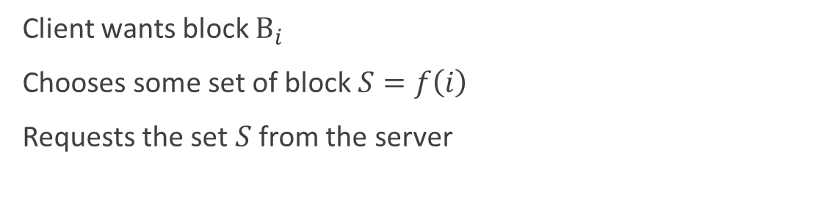



ORAM General Construction
Goal: hide the client’s logical access pattern
storage
$$O(n)$$
$$S_{3}$$
$$S_{1}$$
Logical access pattern
$$⊆$$
Physical access pattern
client
server
$$S_{4}$$
Client wants block $B_{i}$
Chooses some set of block $S=f\left(i\right)$
Requests the set $S$ from the server
$$S_{2}$$
Oregon State University

Slide 6

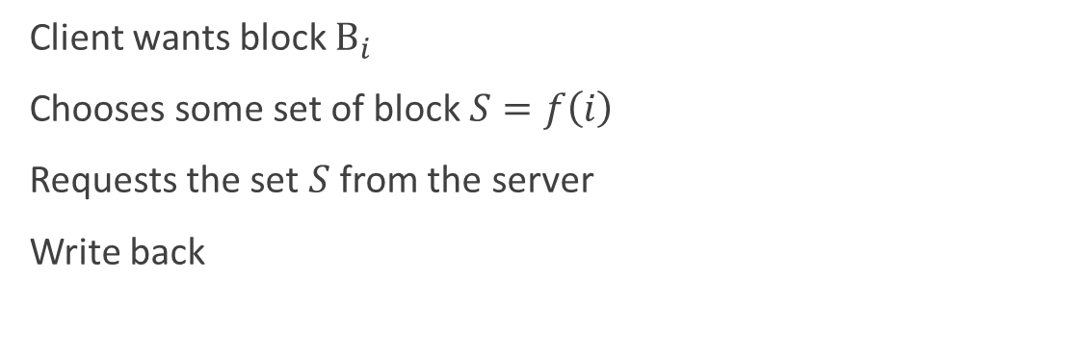
ORAM General Construction
Goal: hide the client’s logical access pattern
storage
$$O(n)$$
$$S_{3}$$
$$S_{1}$$
$$B_{i}$$
client
server
$$S_{4}$$
Client wants block $B_{i}$
Chooses some set of block $S=f\left(i\right)$
Requests the set $S$ from the server
Write back
$$S_{2}$$
Oregon State University

Slide 7
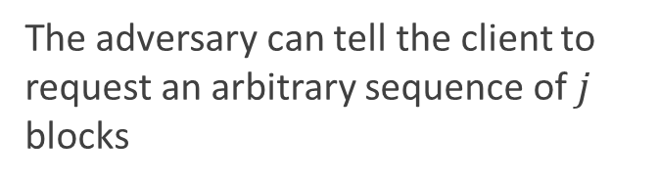
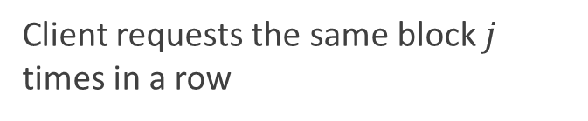
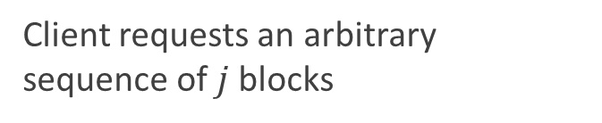
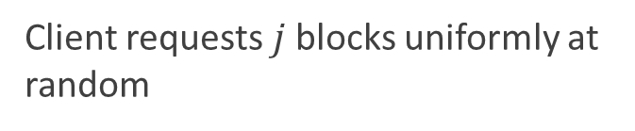
ORAM Security Game
Real world
Ideal world
Client requests the same block $j$ times in a row
Client requests $j$ blocks uniformly at random
Client requests an arbitrary sequence of $j$ blocks
The adversary can tell the client to request an arbitrary sequence of $j$ blocks
Indistinguishable for the adversary (server)
Oregon State University

Slide 8
Naive ORAM
storage
$$O(n)$$
client
server
Simply download then entire server side memory every time you want to access a memory region
Oregon State University

Slide 9
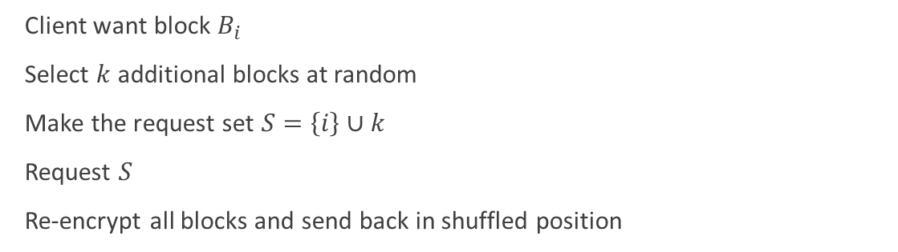
Insecure ORAM
storage
$$O(n)$$
$$S_{3}$$
$$S_{1}$$
$$B_{i}$$
client
server
Client want block $B_{i}$
Select $k$ additional blocks at random
Make the request set $S=\left\{i\right\}∪k$
Request $S$
Re-encrypt all blocks and send back in shuffled position
$$S_{4}$$
$$S_{2}$$
Oregon State University

Slide 10
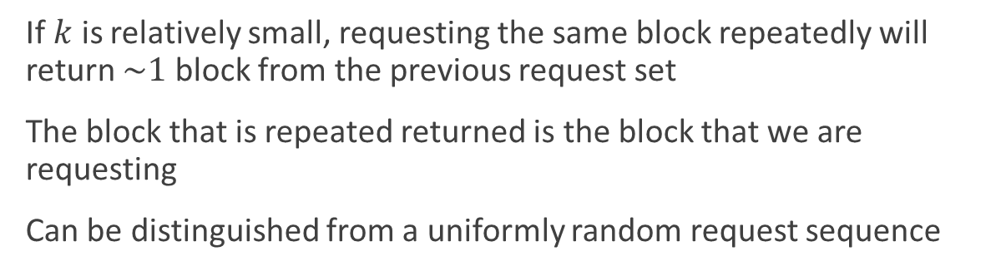
Insecure ORAM Attack
storage
$$O(n)$$
$$S_{3}$$
$$S_{1}$$
client
server
If $k$ is relatively small, requesting the same block repeatedly will return $\sim 1$ block from the previous request set
The block that is repeated returned is the block that we are requesting
Can be distinguished from a uniformly random request sequence
$$S_{4}$$
$$S_{2}$$
Oregon State University

Slide 11
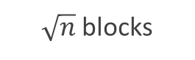
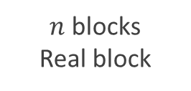
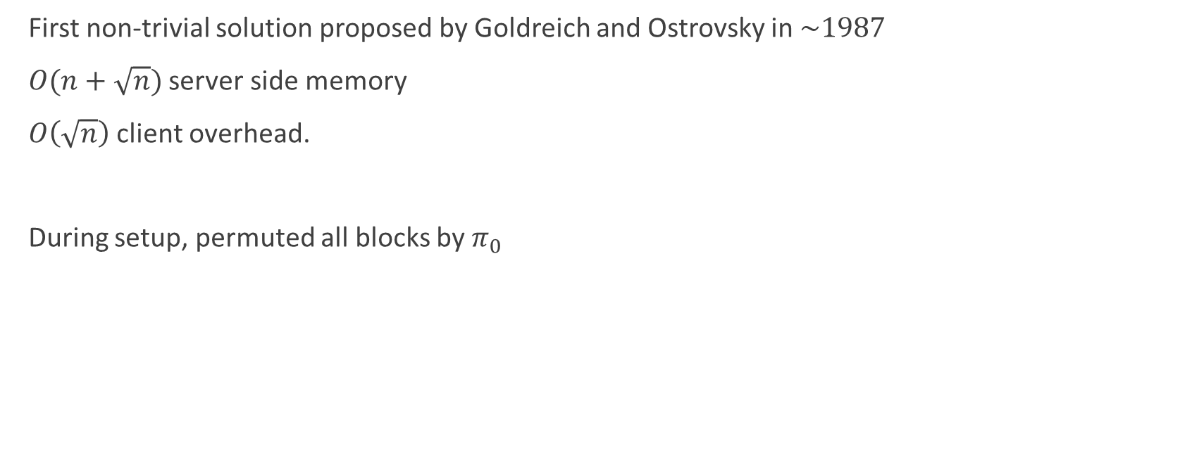
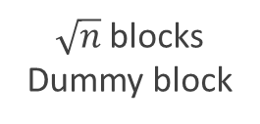
Square Root ORAM
First non-trivial solution proposed by Goldreich and Ostrovsky in $\sim 1987$
$O(n+\sqrt{n})$ server side memory
$O\left(\sqrt{n}\right)$ client overhead.
During setup, permuted all blocks by $π_{0}$
Permutation
memory
Shelter
memory
4
10
2
12
5
7
1
8
9
3
13
6
11
$n$ blocks
Real block
$\sqrt{n}$ blocks
Dummy block
$\sqrt{n}$ blocks
Oregon State University

Slide 12
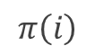
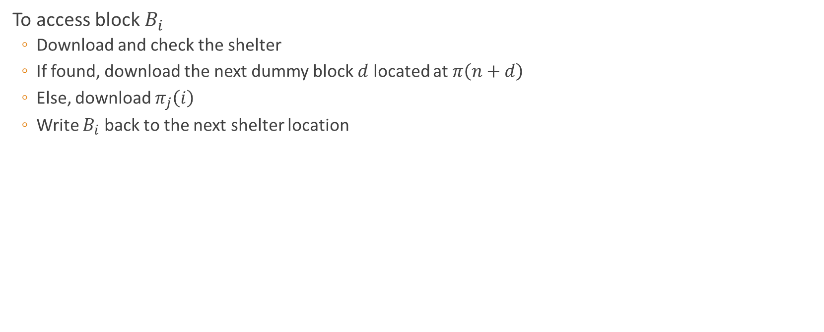
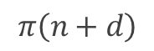
Square Root ORAM
To access block $B_{i}$
Download and check the shelter
If found, download the next dummy block $d$ located at $π\left(n+d\right)$
Else, download $π_{j}\left(i\right)$
Write $B_{i}$ back to the next shelter location
$$π\left(n+d\right)$$
$$π\left(i\right)$$
Permutation
memory
Shelter
memory
4
10
2
12
5
7
1
8
9
3
3
13
6
11
3
$n$ blocks
Real block
$\sqrt{n}$ blocks
Dummy block
$\sqrt{n}$ blocks
Oregon State University

Slide 13
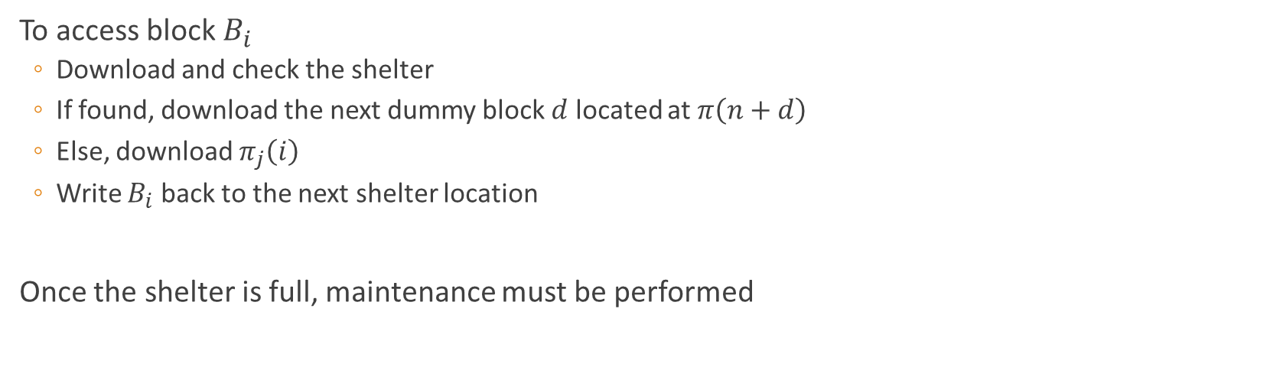
Square Root ORAM
To access block $B_{i}$
Download and check the shelter
If found, download the next dummy block $d$ located at $π\left(n+d\right)$
Else, download $π_{j}\left(i\right)$
Write $B_{i}$ back to the next shelter location
Once the shelter is full, maintenance must be performed
Permutation
memory
Shelter
memory
4
10
2
12
5
7
1
8
9
3
13
6
11
3
12
6
4
$n$ blocks
Real block
$\sqrt{n}$ blocks
Dummy block
$\sqrt{n}$ blocks
Oregon State University

Slide 14
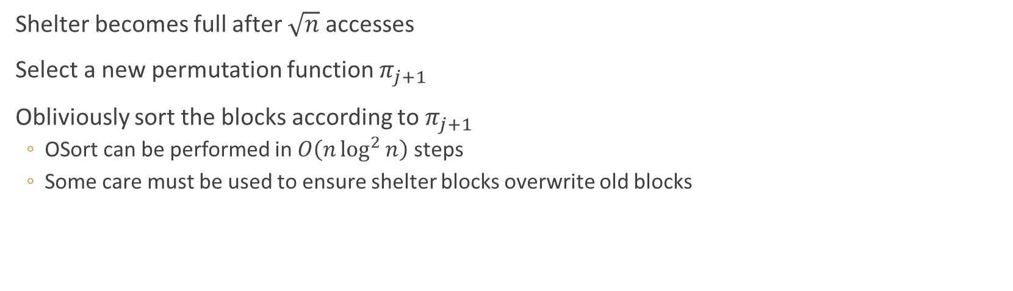
Square Root ORAM
Shelter becomes full after $\sqrt{n}$ accesses
Select a new permutation function $π_{j+1}$
Obliviously sort the blocks according to $π_{j+1}$
OSort can be performed in $O\left(n\log^{2}{n}\right)$ steps
Some care must be used to ensure shelter blocks overwrite old blocks
Permutation
memory
Shelter
memory
10
5
6
2
9
1
7
11
4
13
12
3
8
4
10
2
12
5
7
1
8
9
3
13
6
11
3
12
6
4
$n$ blocks
Real block
$\sqrt{n}$ blocks
Dummy block
$\sqrt{n}$ blocks
Oregon State University

Slide 15
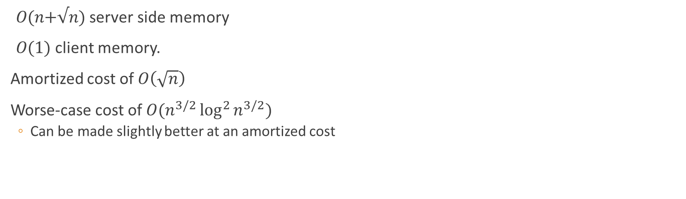
Square Root ORAM
𝑂(𝑛+√𝑛) server side memory
𝑂(1) client memory.
Amortized cost of $O\left(\sqrt{n}\right)$
Worse-case cost of $O(n^{3/2}\log^{2}{n^{3/2}})$
Can be made slightly better at an amortized cost
Permutation
memory
Shelter
memory
10
5
6
2
9
1
7
11
4
13
12
3
8
$n$ blocks
Real block
$\sqrt{n}$ blocks
Dummy block
$\sqrt{n}$ blocks
Oregon State University

Slide 16



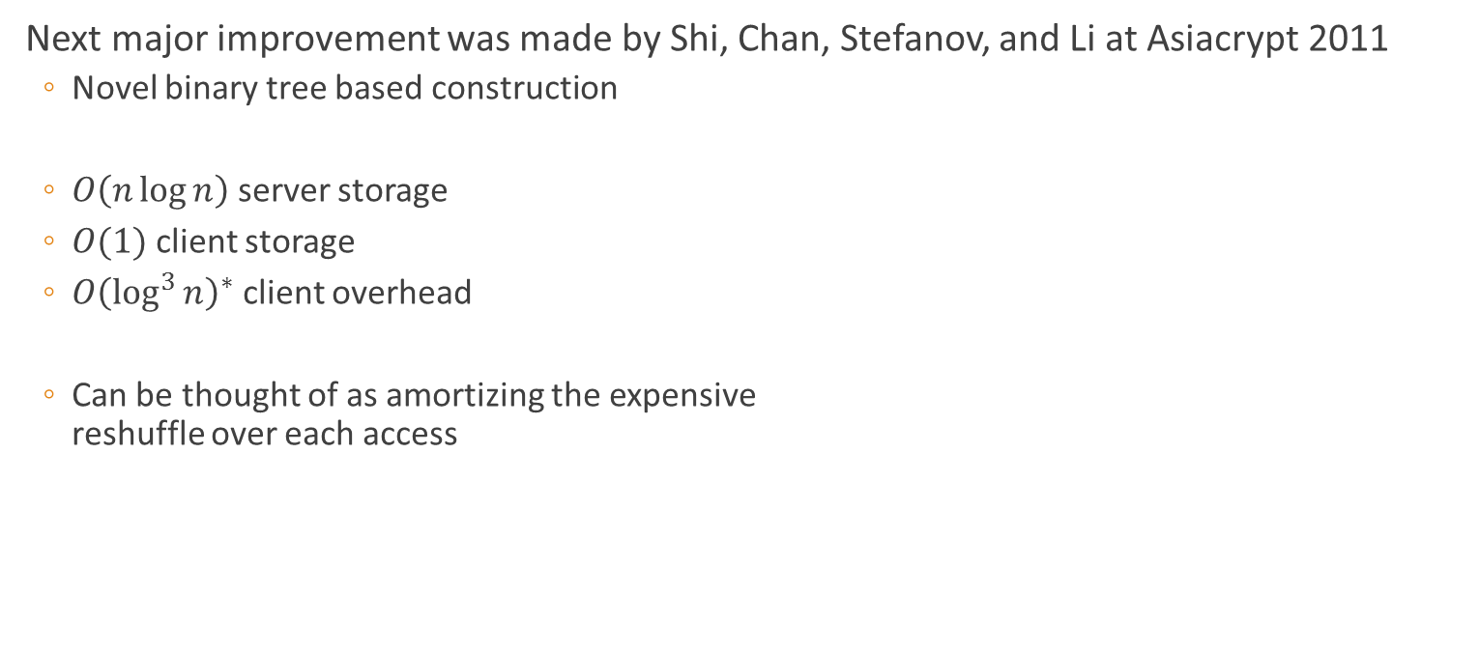


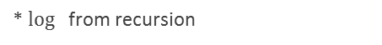





Tree ORAM
Next major improvement was made by Shi, Chan, Stefanov, and Li at Asiacrypt 2011
Novel binary tree based construction
$O\left(n\log{n}\right)$ server storage
$O(1)$ client storage
$O{\left(\log^{3}{n}\right)}^{∗}$ client overhead
Can be thought of as amortizing the expensive reshuffle over each access
$$6$$
8
$$1$$
9
$$7$$
$$4$$
$$5$$
$$3$$
$$11$$
$$10$$
$$12$$
$$2$$
* $\log{ }$ from recursion
Leaf Indices: 0 1 2 3 4 5 6 7
Oregon State University

Slide 17


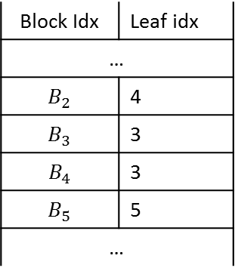

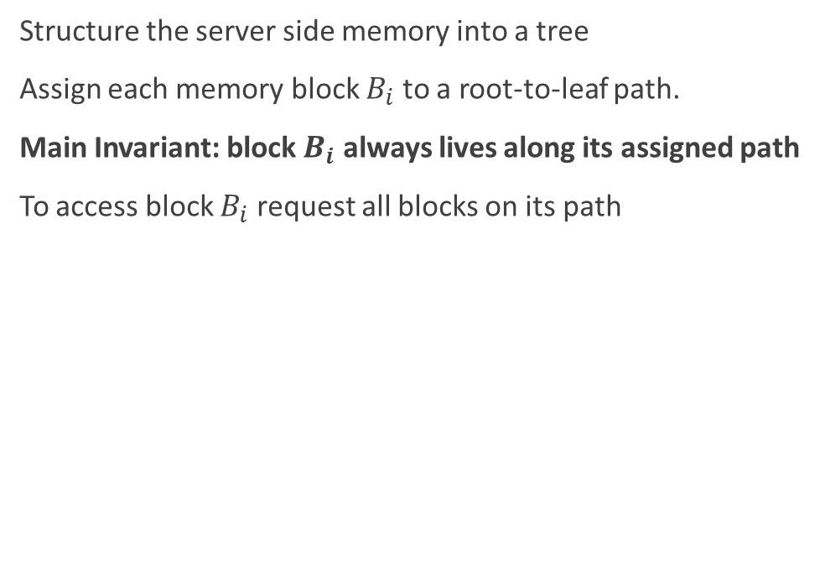

Tree ORAM
Structure the server side memory into a tree
Assign each memory block $B_{i}$ to a root-to-leaf path.
Main Invariant: block $B_{i}$ always lives along its assigned path
To access block $B_{i}$ request all blocks on its path
Position map
$$6$$
$$6$$
8
Block Idx | Leaf idx
…
$$B_{2}$$ | 4
$$B_{3}$$ | 3
$$B_{4}$$ | 3
$$B_{5}$$ | 5
…
8
$$1$$
9
$$1$$
$$7$$
$$4$$
$$5$$
$$3$$
$$11$$
$$4$$
$$12$$
$$2$$
$$10$$
$$12$$
Leaf Indices: 0 1 2 3 4 5 6 7
Oregon State University

Slide 18

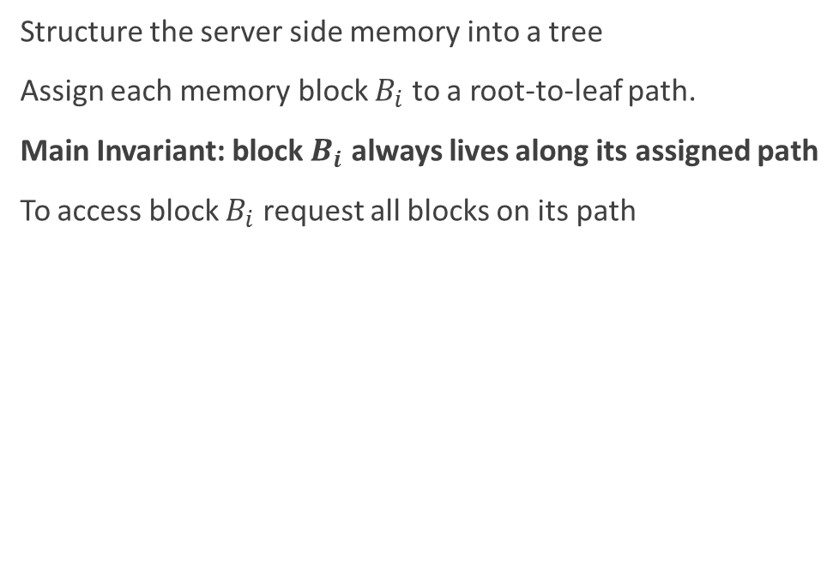
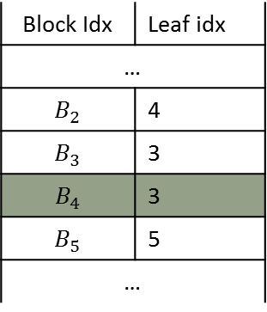
Tree ORAM
Structure the server side memory into a tree
Assign each memory block $B_{i}$ to a root-to-leaf path.
Main Invariant: block $B_{i}$ always lives along its assigned path
To access block $B_{i}$ request all blocks on its path
Position map
$$6$$
$$6$$
8
Block Idx | Leaf idx
…
$$B_{2}$$ | 4
$$B_{3}$$ | 3
$$B_{4}$$ | 3
$$B_{5}$$ | 5
…
8
$$1$$
9
$$1$$
1) Assign new leaf idx
7
2) Update value
$$7$$
$$5$$
$$3$$
$$11$$
$$4′$$
$$4$$
$$4$$
$$12$$
$$2$$
$$10$$
$$12$$
Leaf Indices: 0 1 2 3 4 5 6 7
Oregon State University

Slide 19
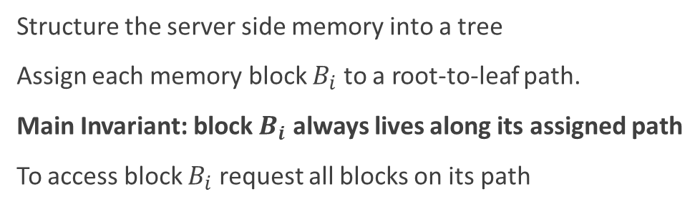

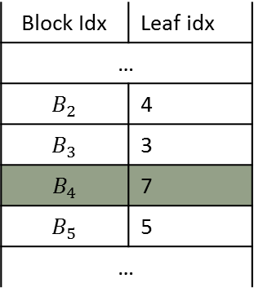



Tree ORAM
Structure the server side memory into a tree
Assign each memory block $B_{i}$ to a root-to-leaf path.
Main Invariant: block $B_{i}$ always lives along its assigned path
To access block $B_{i}$ request all blocks on its path
Position map
Block Idx | Leaf idx
…
$$B_{2}$$ | 4
$$B_{3}$$ | 3
$$B_{4}$$ | 7
$$B_{5}$$ | 5
…
$$6$$
$$4′$$
8
$$6$$
8
$$1$$
$$1$$
9
1) Assign new leaf idx
2) Update value
$$7$$
$$4$$
$$5$$
$$3$$
$$11$$
3) Re-encrypt
4) write back
$$12$$
$$10$$
$$12$$
$$2$$
Leaf Indices: 0 1 2 3 4 5 6 7
Oregon State University

Slide 20




Tree ORAM
Structure the server side memory into a tree
Assign each memory block $B_{i}$ to a root-to-leaf path.
Main Invariant: block $B_{i}$ always lives along its assigned path
To access block $B_{i}$ request all blocks on its path
Position map
Block Idx | Leaf idx
…
$$B_{2}$$ | 4
$$B_{3}$$ | 3
$$B_{4}$$ | 7
$$B_{5}$$ | 5
…
$$6$$
$$4′$$
8
$$1$$
9
1) Assign new leaf idx
2) Update value
$$7$$
$$5$$
$$3$$
$$11$$
3) Re-encrypt
4) write back
$$10$$
$$12$$
$$2$$
Leaf Indices: 0 1 2 3 4 5 6 7
Oregon State University

Slide 21

Tree ORAM
Eventually, root node will fill up
Need a way to push blocks back down the tree
Randomly select one node from each level
Position map
Block Idx | Leaf idx
…
$$B_{2}$$ | 4
$$B_{3}$$ | 3
$$B_{4}$$ | 7
$$B_{5}$$ | 5
…
$$6$$
$$4′$$
8
$$1$$
9
$$7$$
$$5$$
$$3$$
$$11$$
$$7$$
$$10$$
$$12$$
$$2$$
Leaf Indices: 0 1 2 3 4 5 6 7
Oregon State University

Slide 22



Tree ORAM
Eventually, root node will fill up
Need a way to push blocks back down the tree
Randomly select one node from each level
Push to children
Position map
Block Idx | Leaf idx
…
$$B_{2}$$ | 4
$$B_{3}$$ | 3
$$B_{4}$$ | 7
$$B_{5}$$ | 5
…
$$6$$
$$4′$$
8
$$1$$
$$1$$
9
$$1$$
$$7$$
$$7$$
$$5$$
$$3$$
$$11$$
$$7$$
$$10$$
$$12$$
$$2$$
Leaf Indices: 0 1 2 3 4 5 6 7
Oregon State University

Slide 23

Tree ORAM
Eventually, root node will fill up
Need a way to push blocks back down the tree
Randomly select one node from each level
Push to children
Re-encrypt and write back
Position map
Block Idx | Leaf idx
…
$$B_{2}$$ | 4
$$B_{3}$$ | 3
$$B_{4}$$ | 7
$$B_{5}$$ | 5
…
$$6$$
$$4′$$
8
$$1$$
9
$$7$$
1
$$7$$
$$5$$
$$3$$
$$11$$
$$10$$
$$12$$
$$2$$
Leaf Indices: 0 1 2 3 4 5 6 7
Oregon State University

Slide 24
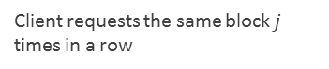
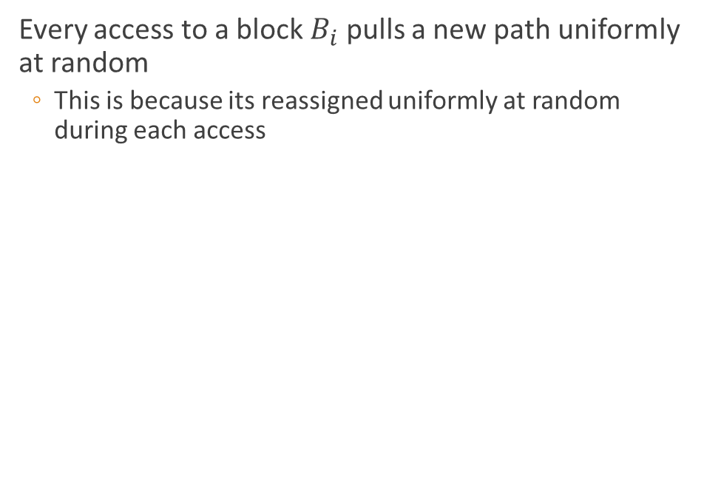
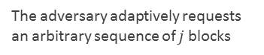
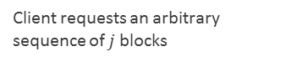
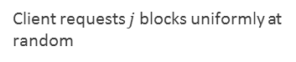
Tree ORAM Security
Every access to a block $B_{i}$ pulls a new path uniformly at random
This is because its reassigned uniformly at random during each access
Real world
Ideal world
Client requests the same block $j$ times in a row
Client requests $j$ blocks uniformly at random
$$6$$
$$4′$$
8
Client requests an arbitrary sequence of $j$ blocks
$$1$$
9
The adversary adaptively requests an arbitrary sequence of $j$ blocks
$$7$$
$$5$$
$$3$$
$$11$$
Indistinguishable for the adversary
$$10$$
$$12$$
$$2$$
Leaf Indices: 0 1 2 3 4 5 6 7
Oregon State University

Slide 25









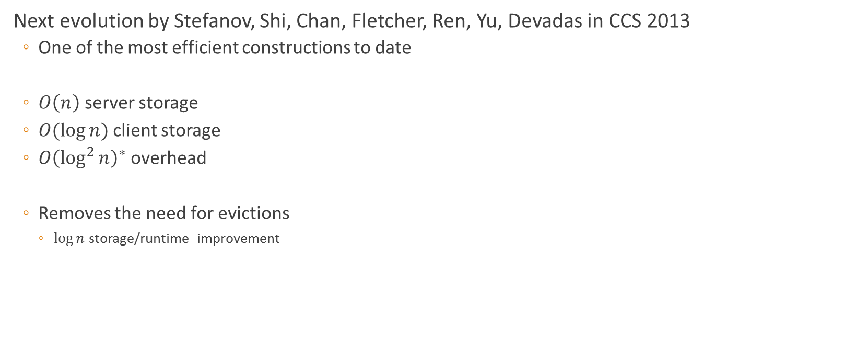














Path ORAM
Next evolution by Stefanov, Shi, Chan, Fletcher, Ren, Yu, Devadas in CCS 2013
One of the most efficient constructions to date
$O\left(n\right)$ server storage
$O(\log{n})$ client storage
$O{\left(\log^{2}{n}\right)}^{∗}$ overhead
Removes the need for evictions
$\log{n}$ storage/runtime improvement
$$B_{14}$$
$$14$$
$$B_{4}$$
$$B_{0}$$
$$13$$
$$0$$
$$B_{0}$$
$$B_{4}$$
$$4$$
$$6$$
$$B_{14}$$
$$2$$
$$15$$
$$1$$
$$11$$
$$9$$
$$B_{3}$$
$$7$$
$$5$$
$$10$$
$$12$$
$$3$$
$$B_{3}$$
* $\log{ }$ from recursion
Leaf Indices: 0 1 2 3 4 5 6 7
Oregon State University

Slide 26
Path ORAM
Structure the server side memory into a tree
Assign each memory block $B_{i}$ to a root-to-leaf path.
Main Invariant: block $B_{i}$ always lives along its assigned path
To access block $B_{i}$ request all blocks on its path
Position map
$$B_{14}$$
$$14$$
Block Idx | Leaf idx
…
$$B_{2}$$ | 4
$$B_{3}$$ | 3
$$B_{4}$$ | 3
$$B_{5}$$ | 5
…
$$B_{4}$$
$$B_{0}$$
$$13$$
$$0$$
$$B_{0}$$
$$B_{4}$$
$$4$$
$$6$$
$$B_{14}$$
$$2$$
$$15$$
$$1$$
$$11$$
$$9$$
$$B_{3}$$
$$7$$
$$5$$
$$10$$
$$12$$
$$3$$
$$B_{3}$$
Leaf Indices: 0 1 2 3 4 5 6 7
Oregon State University

Slide 27





Path ORAM
Structure the server side memory into a tree
Assign each memory block $B_{i}$ to a root-to-leaf path.
Main Invariant: block $B_{i}$ always lives along its assigned path
To access block $B_{i}$ request all blocks on its path
Position map
$$14$$
$$B_{14}$$
$$14$$
Block Idx | Leaf idx
…
$$B_{2}$$ | 4
$$B_{3}$$ | 3
$$B_{4}$$ | 3
$$B_{5}$$ | 5
…
$$B_{4}$$
$$B_{0}$$
$$13$$
$$0$$
$$B_{0}$$
$$0$$
1) Assign new leaf idx
7
2) Update value
$$4′$$
$$B_{4}$$
$$4$$
$$6$$
$$B_{14}$$
$$2$$
$$15$$
$$4$$
$$1$$
$$11$$
$$9$$
$$B_{3}$$
$$7$$
$$5$$
$$10$$
$$12$$
$$3$$
$$B_{3}$$
$$3$$
Leaf Indices: 0 1 2 3 4 5 6 7
Oregon State University

Slide 28

Path ORAM
Structure the server side memory into a tree
Assign each memory block $B_{i}$ to a root-to-leaf path.
Main Invariant: block $B_{i}$ always lives along its assigned path
To access block $B_{i}$ request all blocks on its path
Position map
$$14$$
$$B_{14}$$
$$14$$
Block Idx | Leaf idx
…
$$B_{2}$$ | 4
$$B_{3}$$ | 3
$$B_{4}$$ | 7
$$B_{5}$$ | 5
…
$$B_{4}$$
$$0$$
$$B_{0}$$
$$13$$
$$0$$
$$B_{0}$$
1) Assign new leaf idx
2) Update value
$$4′$$
$$B_{4}$$
$$4$$
3) Re-encrypt
$$6$$
$$B_{14}$$
$$2$$
$$15$$
4) Pushdown & write back
$$3$$
$$1$$
$$11$$
$$9$$
$$B_{3}$$
$$7$$
$$5$$
$$10$$
$$12$$
$$3$$
$$B_{3}$$
Leaf Indices: 0 1 2 3 4 5 6 7
Oregon State University

Slide 29
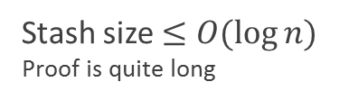
Path ORAM
Structure the server side memory into a tree
Assign each memory block $B_{i}$ to a root-to-leaf path.
Main Invariant: block $B_{i}$ always lives along its assigned path
To access block $B_{i}$ request all blocks on its path
, or in the stash
Position map
Stash
$$14$$
$$B_{14}$$
Block Idx | Leaf idx
…
$$B_{2}$$ | 4
$$B_{3}$$ | 3
$$B_{4}$$ | 7
$$B_{5}$$ | 5
…
$$4$$
…
0
$$B_{0}$$
$$13$$
$$0$$
Stash size $≤O(\log{n)}$
Proof is quite long
$$B_{0}$$
1) Assign new leaf idx
2) Update value
$$4′$$
$$6$$
$$4$$
$$2$$
$$15$$
3) Re-encrypt
4) Pushdown & write back
$$3$$
$$1$$
$$11$$
$$9$$
$$B_{3}$$
$$7$$
$$5$$
$$10$$
$$12$$
$$3$$
$$B_{3}$$
Leaf Indices: 0 1 2 3 4 5 6 7
Oregon State University

Slide 30
Ring ORAM
Introduced by Reny, Fletchery, Kwony, Stefanov, Shi, Dijkz, Devadas 2014
Base on Path ORAM but in the online/offline setting
Online requests should have very small overhead
Offline work will perform maintains for the next online phase
Closes the gap between large and small client storage
Oregon State University

Slide 31

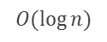
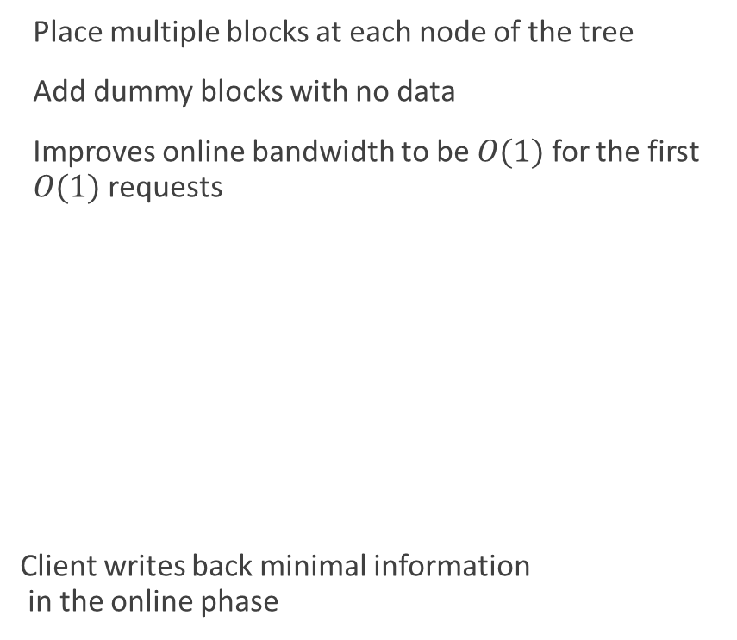

Ring ORAM
Place multiple blocks at each node of the tree
Add dummy blocks with no data
Improves online bandwidth to be $O(1)$ for the first $O(1)$ requests
Client writes back minimal information in the online phase
$$⊕$$
Unused dummy blocks start to be depleted
$$⊕$$
Online bandwidth per block
$$O(\log{n})$$
Number of requested Block
Leaf Indices: 0 1 2 3 4 5 6 7
Oregon State University

Slide 32
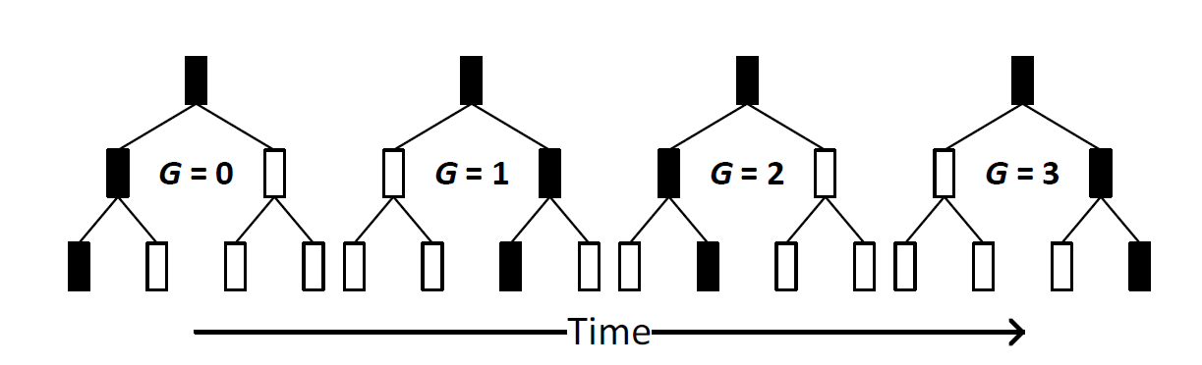
Ring ORAM
Online work limited by allowed stash size
Stash grows in size during online phase
Offline work consists of writing block back to the server
Paths are evicted in deterministic reverse lexicographic order
Leaf Indices: 0 1 2 3 4 5 6 7
Reverse Lexicographic order: 0 4 2 6 1 5 3 7
Oregon State University

Slide 33
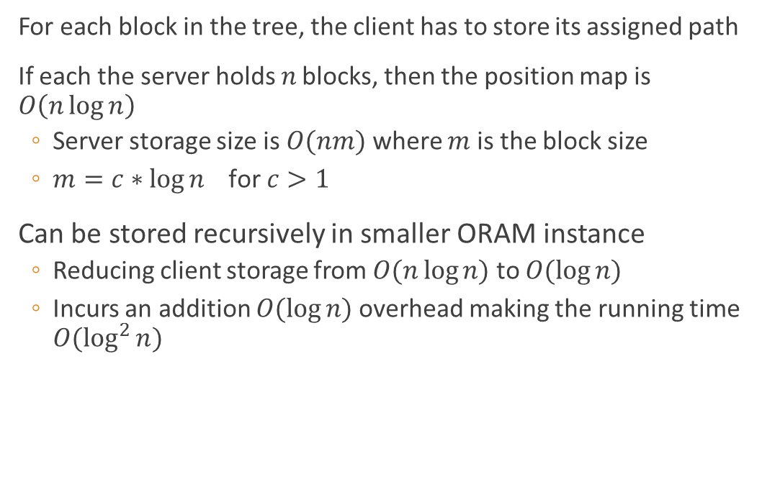
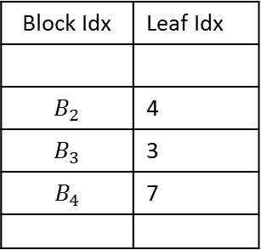
Position map
For each block in the tree, the client has to store its assigned path
If each the server holds $n$ blocks, then the position map is $O\left(n\log{n}\right)$
Server storage size is $O(nm)$ where $m$ is the block size
$m=c∗\log{n} \text{for} c>1$
Can be stored recursively in smaller ORAM instance
Reducing client storage from $O(n\log{n)}$ to $O(\log{n)}$
Incurs an addition $O(\log{n)}$ overhead making the running time $O(\log^{2}{n)}$
Position map
Block Idx | Leaf Idx
$$B_{2}$$ | 4
$$B_{3}$$ | 3
$$B_{4}$$ | 7
…
…
Main ORAM
Position map
Position map
Oregon State University

Slide 34
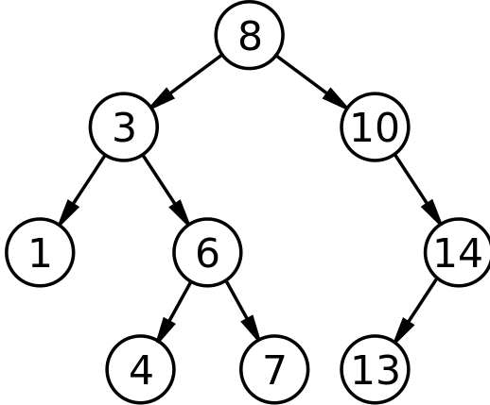















Oblivious Data Structures
Data structure
Also introduced by the usual suspects; Wang, Nayak, Liu, Chan, Shi, Stefanov, Huang at CCS 2014
Idea is to remove the need to explicitly store the position map
Take advantage of the existing structure
ORAM Tree
$$B_{4}$$
$$B_{0}$$
$$B_{13}$$
$$B_{6}$$
$$B_{14}$$
$$B_{2}$$
$$B_{15}$$
$$B_{1}$$
$$B_{11}$$
$$B_{9}$$
$$B_{3}$$
$$B_{7}$$
$$B_{5}$$
$$B_{10}$$
$$B_{12}$$
0 1 2 3 4 5 6 7
Oregon State University

Slide 35
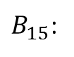
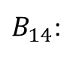
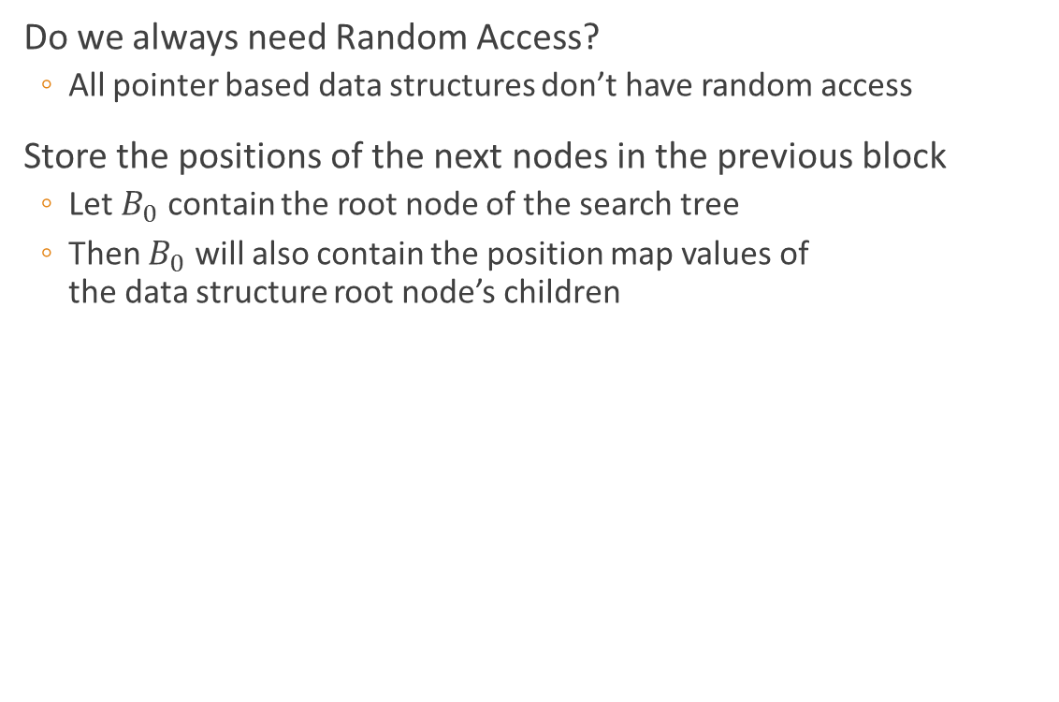
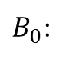
Oblivious Data Structures
Data structure
Do we always need Random Access?
All pointer based data structures don’t have random access
Store the positions of the next nodes in the previous block
Let $B_{0}$ contain the root node of the search tree
Then $B_{0}$ will also contain the position map values of the data structure root node’s children
ORAM Tree
$B_{0}$:
8
$$B_{4}$$
Leaf Idx 2
Leaf Idx 6
$$B_{0}$$
$$B_{13}$$
$B_{14}$:
3
$B_{15}$:
10
$$B_{6}$$
$$B_{14}$$
$$B_{2}$$
$$B_{15}$$
Leaf Idx 5
Leaf Idx 1
Leaf Idx 2
$$B_{1}$$
$$B_{11}$$
$$B_{9}$$
$$B_{3}$$
$$B_{7}$$
$$B_{5}$$
$$B_{10}$$
$$B_{12}$$
0 1 2 3 4 5 6 7
Oregon State University

Slide 36






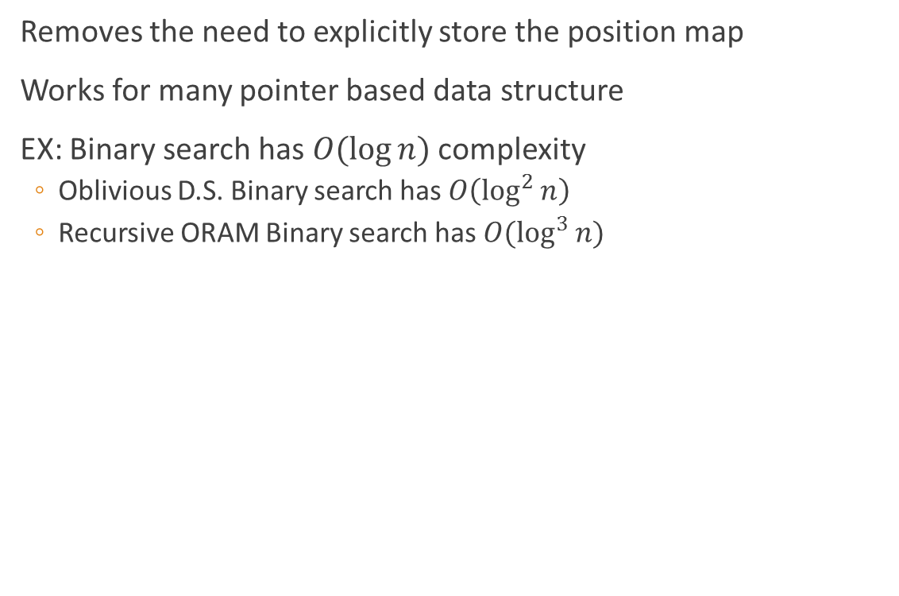









Oblivious Data Structures
Data structure
Removes the need to explicitly store the position map
Works for many pointer based data structure
EX: Binary search has $O(\log{n})$ complexity
Oblivious D.S. Binary search has $O\left(\log^{2}{n}\right)$
Recursive ORAM Binary search has $O(\log^{3}{n)}$
ORAM Tree
$$B_{4}$$
$$B_{0}$$
$$B_{13}$$
$$B_{6}$$
$$B_{14}$$
$$B_{2}$$
$$B_{15}$$
$$B_{1}$$
$$B_{11}$$
$$B_{9}$$
$$B_{3}$$
$$B_{7}$$
$$B_{5}$$
$$B_{10}$$
$$B_{12}$$
0 1 2 3 4 5 6 7
Oregon State University

Slide 37
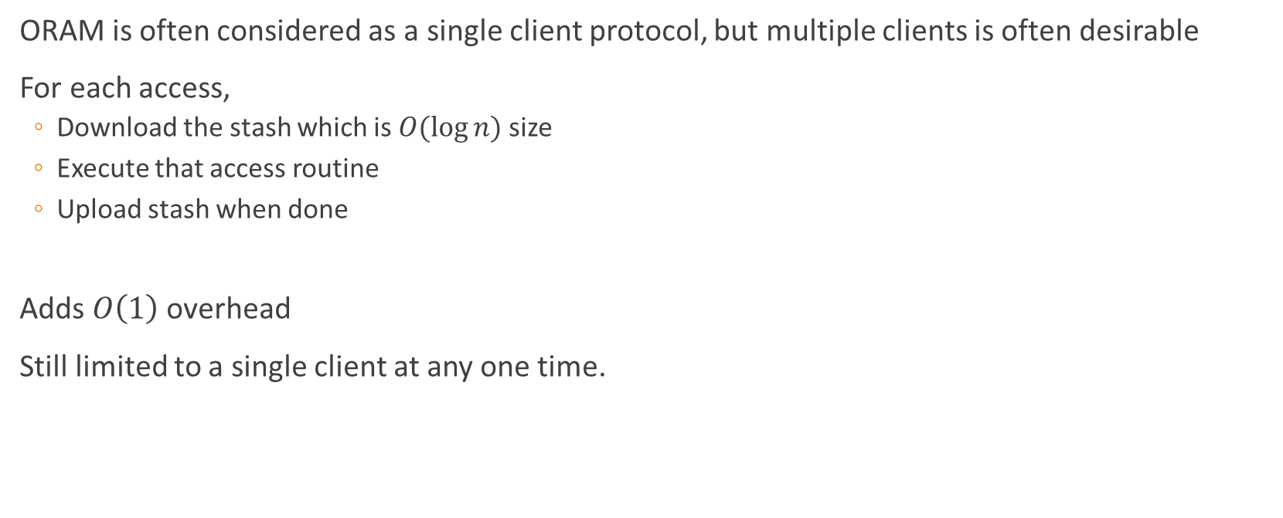
Stateless ORAM
ORAM is often considered as a single client protocol, but multiple clients is often desirable
For each access,
Download the stash which is $O(\log{n)}$ size
Execute that access routine
Upload stash when done
Adds $O\left(1\right)$ overhead
Still limited to a single client at any one time.
Oregon State University

Slide 38
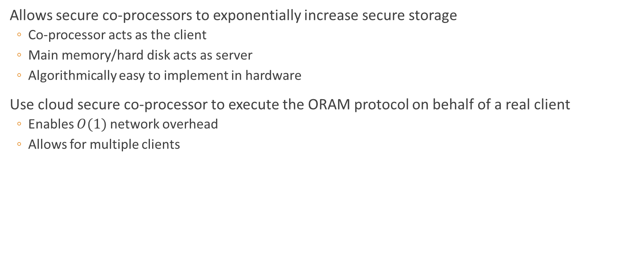
ORAM with Secure Co-Processor
Allows secure co-processors to exponentially increase secure storage
Co-processor acts as the client
Main memory/hard disk acts as server
Algorithmically easy to implement in hardware
Use cloud secure co-processor to execute the ORAM protocol on behalf of a real client
Enables $O(1)$ network overhead
Allows for multiple clients
server
Hard disk
Request file
Secure Co-processor
ORAM
client
file
Oregon State University

Slide 39
Application
Use as a subroutine to make security sensitive protocols more flexible
Secure dropbox
Large programs running on SGX
Secure multi-party computation, allows sub linear execution
Outsourcing large datasets to the cloud
Economy of scale in the cloud
Oregon State University

Slide 40
Future work
Create cool application!
Further improvements to the online/offline setting
Domain specific optimizations
Hybrid with private information retrieval
Large vs small client storage
Some protocols with larger client storage are faster…
Hint of ways to still improve?
True multi client
Homomorphic encryption
Onion ORAM 2015
Other?
Oregon State University

Slide 41
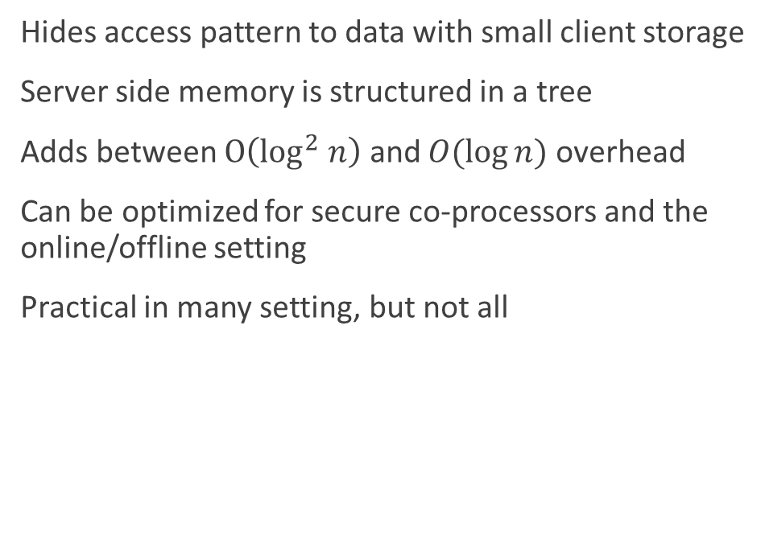
Conclusion
Hides access pattern to data with small client storage
Server side memory is structured in a tree
Adds between $O\left(\log^{2} n\right)$ and $O(\log{n})$ overhead
Can be optimized for secure co-processors and the online/offline setting
Practical in many setting, but not all
Oregon State University

Slide 42
The End
Oregon State University

Slide 43
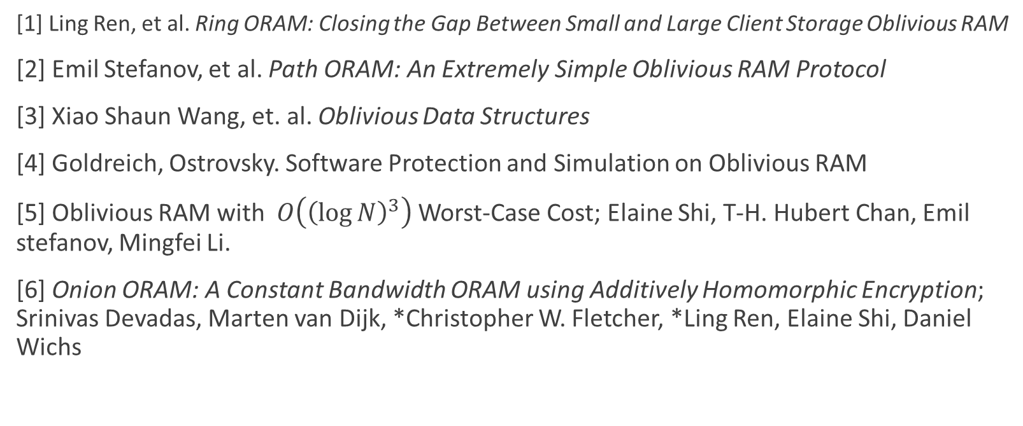
Sources
[1] Ling Ren, et al. Ring ORAM: Closing the Gap Between Small and Large Client Storage Oblivious RAM
[2] Emil Stefanov, et al. Path ORAM: An Extremely Simple Oblivious RAM Protocol
[3] Xiao Shaun Wang, et. al. Oblivious Data Structures
[4] Goldreich, Ostrovsky. Software Protection and Simulation on Oblivious RAM
[5] Oblivious RAM with $O\left({\left(\log{N}\right)}^{3}\right)$Worst-Case Cost; Elaine Shi, T-H. Hubert Chan, Emil stefanov, Mingfei Li.
[6] Onion ORAM: A Constant Bandwidth ORAM using Additively Homomorphic Encryption; Srinivas Devadas, Marten van Dijk, *Christopher W. Fletcher, *Ling Ren, Elaine Shi, Daniel Wichs
Oregon State University

